Slide 1

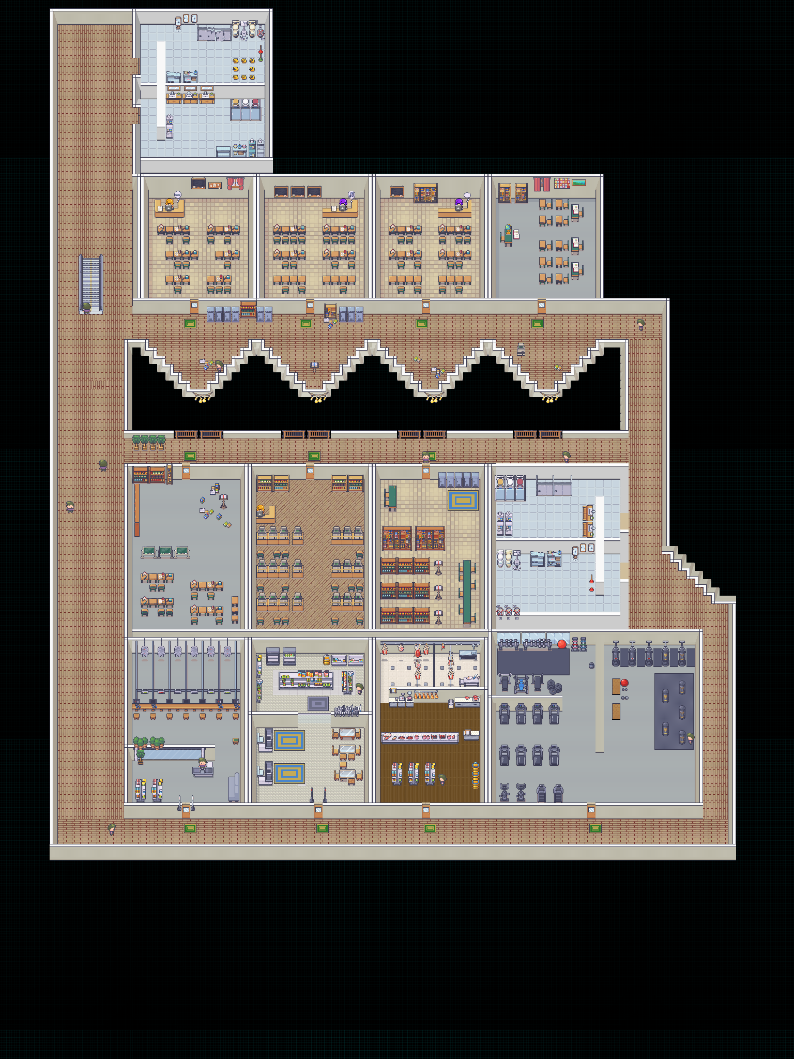
Campus Navigator
Backend System and Web-Based
Administration Client
Pui Hock Yang 24WMR01790
Software Engineering
Supervisor: Prof. Ts. Dr. Tew Yiqi
Abstract
Campus Navigator connects indoor navigation data to a two-page administration website. Go services, Redis and ClickHouse supply current presence and journey summaries. Operators can review popular destinations and follow named users on the shared campus map. Local verification used 100 simulated sessions; Google Cloud deployment remains a planned next step.
Problem Statement
System Features
The mobile application shows an individual route, but operators also need an overview of navigation activity. Internal node IDs and service logs do not clearly show popular destinations or current user movement. A useful administration view must preserve names, align map coordinates and distinguish live sessions from historical journeys.
Dashboard
Today and week views show navigation starts, journey outcomes, daily activity and popular destinations. Labels use place names such as TA257 and Toilet 1. Counts describe journeys, not unique people.
Objectives
Live map
Provide day and week navigation summaries with readable destination names.
Display named active users on the application’s 2D map with 10, 20, 30 or All markers.
Reuse the backend data path and prepare a reproducible VM deployment.
Named user markers refresh from backend snapshots. Choose 10, 20, 30 or All, then pan, zoom or inspect a user. The administrative reader returns all eligible active sessions.
Design and Methodology
Iterative integration
Requirements and prototype feedback guided the two-page interface. API inspection, local simulation and focused tests addressed snapshot completeness, coordinate alignment and visible names.
Backend responsibilities
Presence Gateway accepts session updates and serves current floor snapshots.
Trajectory Worker consumes Redis Streams and inserts journey and trajectory records into ClickHouse.
Analytics API aggregates stored journeys for the dashboard. The web server provides same-origin read proxies.
Shared Floor 2 map asset used by the app and web client
Illustration of the map surface, not a live-data screenshot
One shared coordinate frame
Contribution
Graph positions are interpolated along edges, then converted using the floor image origin (−256, 256). The map and markers pan and zoom together. A marker limit changes only the visible list, not backend ingestion.
A backend-connected view of navigation activity with readable labels, aligned coordinates and separate live and historical data paths. A repeatable simulator supports demonstrations without collecting real students’ locations.
Conclusion
The local prototype delivers a focused dashboard and named live map. Its next milestone is a verified Google Cloud rollout with public HTTPS and private backend HTTP. Administrator access control, stronger event durability and real-world positioning evaluation are required before production use.
Notes:
Title: Campus Navigator: Backend System and Web-Based Administration Client
Author: Pui Hock Yang, 24WMR01790
Supervisor: Prof. Ts. Dr. Tew Yiqi
Source map: project admin-web/public/floor-2.png. Implementation sources: admin-web; services/presence-gateway; services/trajectory-worker; services/analytics-api; dev/verify-admin-local.mjs; deploy/FRONTEND-GCP.md. The 100-session result refers to earlier local synthetic verification, not 100 real participants or a fresh test during report preparation. Google Cloud deployment is planned, not verified. The original poster structure, logo, frame positions and header treatment are retained. Construction and Testing was replaced with System Features at the user’s request.

